Slide 1
Edge Detection

Slide 2
Image Edge Detection
Edges are significant local changes of intensity in a digital image.
An edge can be defined as a set of connected pixels that forms a boundary between two disjoint regions.
There are three types of edges:
Horizontal edges
Vertical edges
Diagonal edges

Slide 3
Image Edge Detection
Edge Detection is a method of segmenting an image into regions of discontinuity.
It is a widely used technique in digital image processing like
pattern recognition
image morphology
feature extraction

Slide 4
Image Edge Detection
Edge detection allows users to observe the features of an image for a significant change in the gray level.
This texture indicating the end of one region in the image and the beginning of another.
It reduces the amount of data in an image and preserves the structural properties of an image.

Slide 5
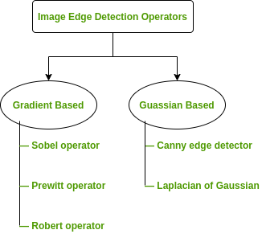
Edge Detection Operators
Edge Detection Operators are of two types:
Gradient – based operator which computes first-order derivations in a digital image like, Sobel operator, Prewitt operator, Robert operator
Gaussian – based operator which computes second-order derivations in a digital image like, Canny edge detector, Laplacian of Gaussian

Slide 6
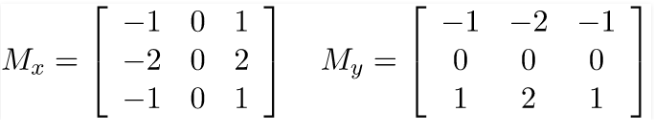
Sobel Operator
It is a discrete differentiation operator.
It computes the gradient approximation of image intensity function for image edge detection.
At the pixels of an image, the Sobel operator produces either the normal to a vector or the corresponding gradient vector.
It uses two 3 x 3 kernels or masks which are convolved with the input image to calculate the vertical and horizontal derivative approximations respectively

Slide 7
Sobel Operator
Approach in MATLAB:
Step 1: Input – Read an image Step 2: Convert the true-color RGB image to the grayscale image Step 3: Convert the image to double Step 4: Pre-allocate the filtered_image matrix with zeros Step 5: Define Sobel Operator Mask Step 6: Edge Detection Process (Compute Gradient approximation and magnitude of vector) Step 7: Display the filtered image Step 8: Thresholding on the filtered image Step 9: Display the edge-detected image

Slide 8
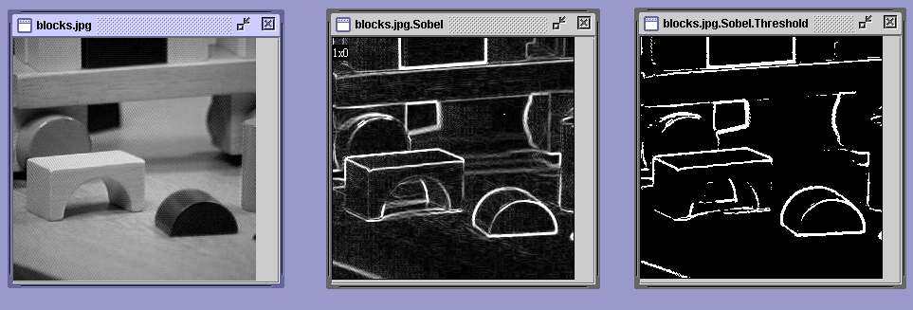
Java Toolkit’s Sobel Operator
original image gradient thresholded
magnitude gradient
magnitude

Slide 9
Sobel Operator
Advantages:
Simple and time efficient computation
Very easy at searching for smooth edges
Limitations:
Diagonal direction points are not preserved always
Highly sensitive to noise
Not very accurate in edge detection
Detect with thick and rough edges does not give appropriate results

Slide 10
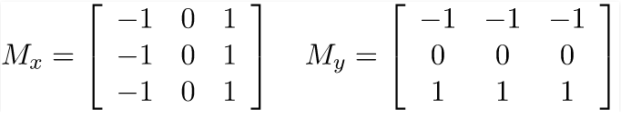
Prewitt Operator
This operator is almost similar to the sobel operator.
It also detects vertical and horizontal edges of an image.
It is one of the best ways to detect the orientation and magnitude of an image.
It uses the kernels or masks –

Slide 11
Prewitt Operator
Advantages:
Good performance on detecting vertical and horizontal edges
Best operator to detect the orientation of an image
Limitations:
The magnitude of coefficient is fixed and cannot be changed
Diagonal direction points are not preserved always

Slide 12

Robert Operator
This gradient-based operator computes the sum of squares of the differences between diagonally adjacent pixels in an image through discrete differentiation.
Then the gradient approximation is made.
It uses the following 2 x 2 kernels or masks –

Slide 13
Robert Operator
Advantages:
Good Detection of edges and orientation are very easy
Diagonal direction points are preserved
Limitations:
Very sensitive to noise
Not very accurate in edge detection

Slide 14
Laplacian of Gaussian (LoG)
It is a gaussian-based operator which uses the Laplacian to take the second derivative of an image.
This really works well when the transition of the grey level seems to be abrupt.
It works on the zero-crossing method i.e. when the second-order derivative crosses zero, then that particular location corresponds to a maximum level. It is called an edge location.
Here the Gaussian operator reduces the noise and the Laplacian operator detects the sharp edges.

Slide 15
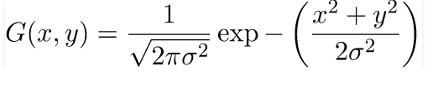

Laplacian of Gaussian (LoG)
The Gaussian function is defined by the formula:
Where is the standard deviation.
And the LoG operator is computed from

Slide 16
Laplacian of Gaussian (LoG)
Advantages:
Easy to detect edges and their various orientations.
There is fixed characteristics in all directions.
Limitations:
Very sensitive to noise.
The localization error may be severe at curved edges.
It generates noisy responses that do not correspond to edges, so-called “false edges”.

Slide 17
Canny Operator
It is a gaussian-based operator in detecting edges.
This operator is not susceptible to noise.
It extracts image features without affecting or altering the feature.
Canny edge detector have advanced algorithm derived from the previous work of Laplacian of Gaussian operator.
It is widely used an optimal edge detection technique.

Slide 18
Canny Operator
It detects edges based on three criteria:
Low error rate
Edge points must be accurately localized
There should be just one single edge response

Slide 19
Canny Operator
Advantages:
It has good localization
It extract image features without altering the features
Less Sensitive to noise
Limitations:
There is false zero crossing
Complex computation and time consuming

Slide 20
Applications of Image Edge Detection
Some Real-world Applications of Image Edge Detection:
medical imaging, study of anatomical structure
locate an object in satellite images
automatic traffic controlling systems
face recognition, and fingerprint recognition

Slide 21
References
[1] https://www.geeksforgeeks.org

Slide 22
Thank You

